Slide 1
Unit 1. Computing Environments
1.2 Number Systems and Character Sets
Binary Numbers and Addition
Hexadecimal Numbers and Addition
ASCII Code and Unicode
Bit-map Images

Slide 2

Binary Number System
Denary number:
31421
The binary system uses 1s and 0s only which gives these corresponding weightings:
A typical binary number would be:

Slide 3
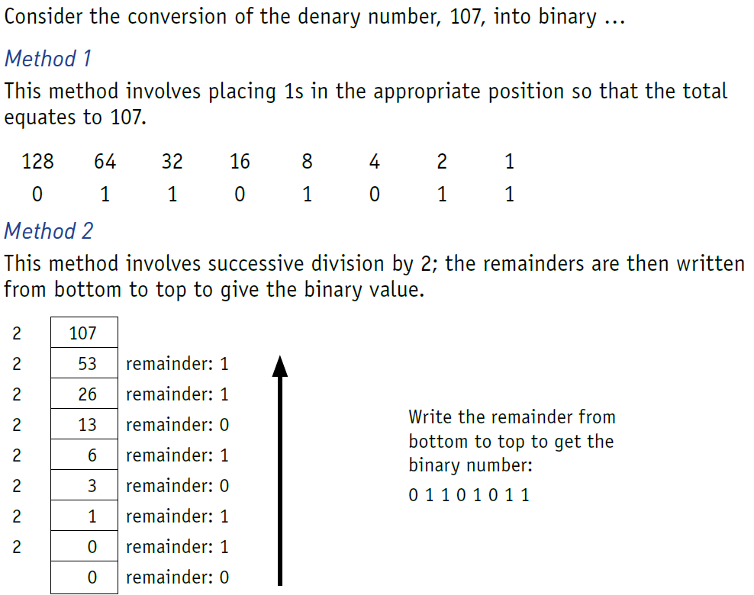
Converting from binary to denary and from denary to binary

Slide 4
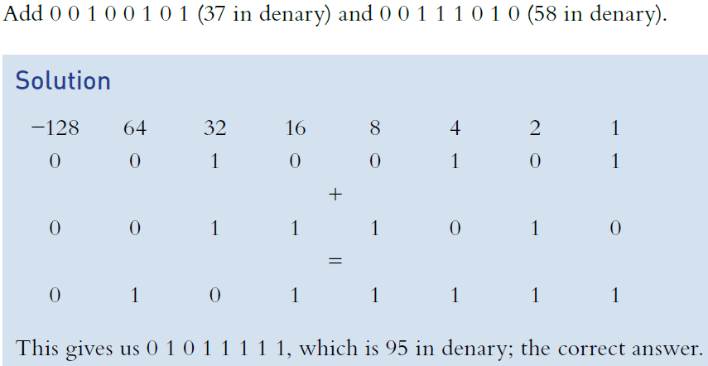
Binary Addition

Slide 5

Binary Addition Practice

Slide 6
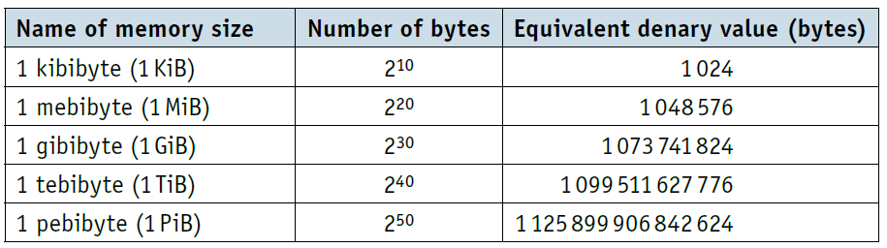
Measurement of the size of computer memories
The byte is the smallest unit of memory in a computer. Some computers use larger bytes, such as 16-bit systems and 32-bit systems, but they are always multiples of 8. 1 byte of memory wouldn’t allow you to store very much information; so memory size is measured in these multiples.
A 64 GiB RAM could, therefore, store 64×2³⁰ bytes of data (68 719 476 736 bytes).
Have you heard of Byte Dance?

Slide 7

Hexadecimal number system
The hexadecimal system is very closely related to the binary system.
Hexadecimal (sometimes referred to as simply hex) is a base 16 system with the weightings:
Because it is a system based on 16 different digits, the numbers 0 to 9 and the letters A to F are used to represent hexadecimal digits.
A = 10, B = 11, C = 12, D = 13, E = 14 and F = 15.

Slide 8
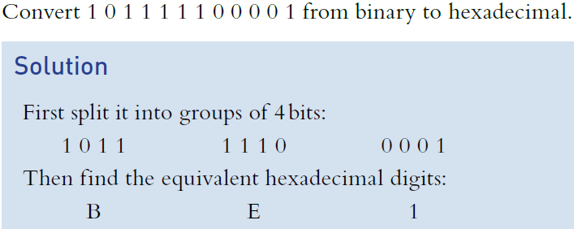
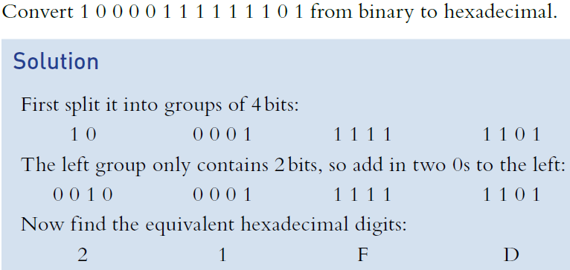
Converting from binary to hexadecimal and from hexadecimal to binary

Slide 9
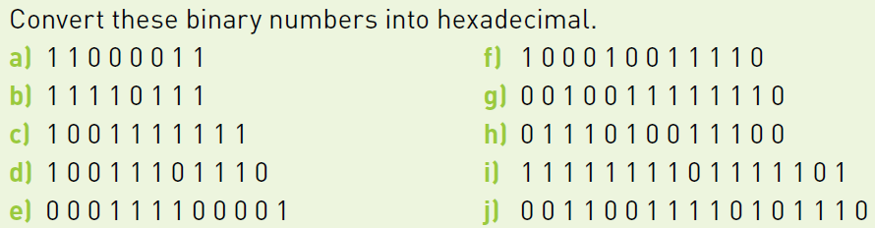
Binary-Hexadecimal Conversion Practice

Slide 10
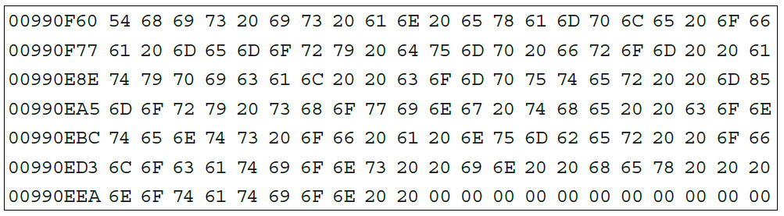
Use of the hexadecimal system
It is much easier to work with:
B 5 A 4 1 A F C
than it is to work with:
1 0 1 1 0 1 0 1 1 0 1 0 0 1 0 0 0 0 0 1 1 0 1 0 1 1 1 1 1 1 0 0
So, hexadecimal is often used when developing new software or when trying to trace errors in programs. When the memory contents are output to a printer or monitor, this is known as a memory dump.
A program developer can look at each of the hexadecimal codes and determine where the error lies. The value on the far left shows the memory location, so it is possible to find out exactly where in memory
the fault occurs. Using hexadecimal is more manageable than binary. It is a powerful fault-tracing tool, but requires considerable knowledge of computer architecture to be able to interpret the results.

Slide 11
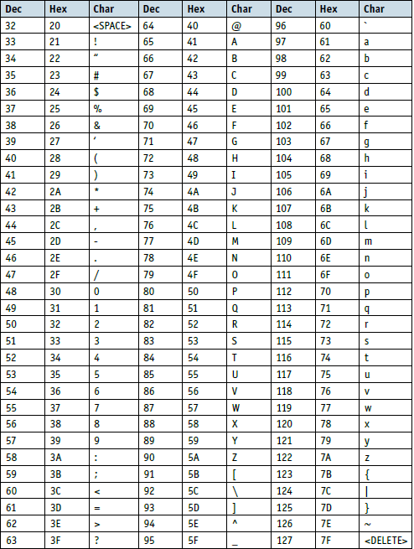
ASCII Code
The ASCII code system (American Standard Code for Information Interchange) was set up in 1963 for use in communication systems and computer systems. The newer version of the code was published in 1986. The standard ASCII code character set consists of 7-bit codes (0 to 127 denary or 0 to 7F in hexadecimal); this represents the letters, numbers and characters found on a standard keyboard together with 32 control codes (which use up codes 0 to 31 (denary) or 0 to 19 (hexadecimal)).

Slide 12
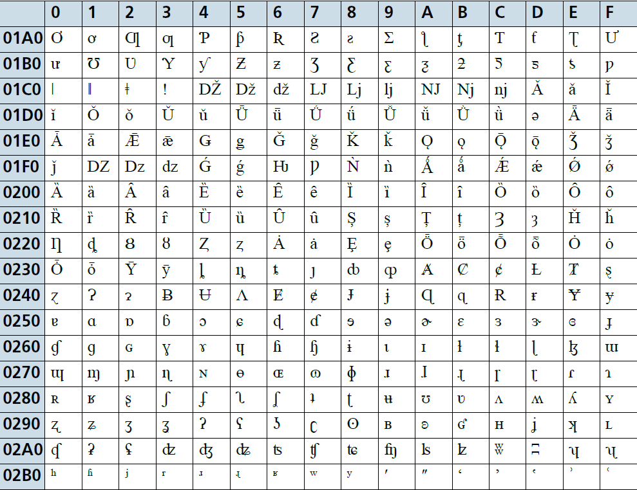
Unicode
Since ASCII code has a number of disadvantages and is unsuitable for some purposes, different methods of coding have been developed over the years.
One coding system is called Unicode. Unicode allows characters in a code form to represent all languages of the world, thus supporting many operating systems, search engines and internet browsers used globally.
There is overlap with standard ASCII code, since the first 128 (English) characters are the same, but Unicode can support several thousand different characters in total.
ASCII uses one byte to represent a character, whereas Unicode will support up to four bytes per character.

Slide 13
Bit-map Images
Bit-map images are made up of pixels (picture elements); the image is stored in a two-dimensional matrix of pixels.
at least 8 bits (1 byte) per pixel are needed to code a coloured image (this gives 256 possible colours by varying the intensity of the blue, green and red elements)
true colour requires 3 bytes per pixel (24 bits), which gives more than one million colours
the number of bits used to represent a pixel is called the colour depth.
the number of bits that are used to represent a single pixel (bit depth) will determine the colour depth of that pixel. As the bit depth increases, the number of possible colours which can be represented also increases. For example, a bit depth of 8 bits per pixel allows 256 (2⁸) different colours (the colour depth) to be represented, whereas using a bit depth of 32 bits per pixel results in 4 294 967 296 (2³²) different colours.
Image resolution refers to the number of pixels that make up an image; for example, an image could contain 4096 × 3192 pixels (12 738 656 pixels in total).
Screen resolution refers to the number of horizontal pixels and the number of vertical pixels that make up a screen display (for example, if the screen resolution is smaller than the image resolution then the whole image cannot be shown on the screen or the original image will now be a lower quality).

Slide 14
Calculating bit-map image file sizes
It is possible to estimate the file size needed to store a bit-map image. The file size will need to take into account the image resolution and bit depth.
For example, a full screen with a resolution of 1920 × 1080 pixels and a bit depth of 24 requires 1920 × 1080 × 24 bits = 49 766 400 bits for the full screen image. Dividing by 8 gives us 6 220 800 bytes (equivalent to 6.222 MB using the SI units or 5.933 MiB using IEE units).
An image which does not occupy the full screen will obviously result in a smaller file size.
You try: Find a picture in your album and the resolution of the picture. Calculate the size of the image file and check if it matches with what your system says about the file size.

Slide 15
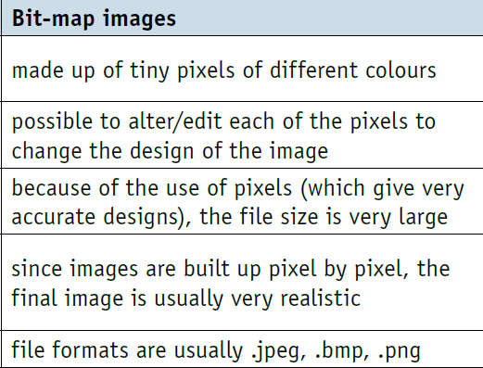
Characteristics of bit-map images

